Slide 1

Harry
https://netty.io
PPT模板下载：www.1ppt.com/moban/ 行业PPT模板：www.1ppt.com/hangye/
节日PPT模板：www.1ppt.com/jieri/ PPT素材下载：www.1ppt.com/sucai/
PPT背景图片：www.1ppt.com/beijing/ PPT图表下载：www.1ppt.com/tubiao/
优秀PPT下载：www.1ppt.com/xiazai/ PPT教程： www.1ppt.com/powerpoint/
Word教程： www.1ppt.com/word/ Excel教程：www.1ppt.com/excel/
资料下载：www.1ppt.com/ziliao/ PPT课件下载：www.1ppt.com/kejian/
范文下载：www.1ppt.com/fanwen/ 试卷下载：www.1ppt.com/shiti/
教案下载：www.1ppt.com/jiaoan/ PPT论坛：www.1ppt.cn

Slide 2
What is a Thread?
Almost every operating system supports independently running programs called processes. Threading is a facility to allow multiple activities to coexist within a single process. Java is the first programming language to explicitly include threading within the language itself, rather than treating it as a facility of the underlying OS.
Threads are sometimes called as lightweight processes. Like processes,they work independently and each thread has its own stack, program counter, and local variables. Even though they have their own stuff, threads within a process are less insulated from each other than separate processes are. They share memory space, file handles, etc. This means they have access to the same variables and objects. While this makes it easier for them to share information, the programmer must be very careful not to let them interfere with each other in the same process.
PPT模板下载：www.1ppt.com/moban/ 行业PPT模板：www.1ppt.com/hangye/
节日PPT模板：www.1ppt.com/jieri/ PPT素材下载：www.1ppt.com/sucai/
PPT背景图片：www.1ppt.com/beijing/ PPT图表下载：www.1ppt.com/tubiao/
优秀PPT下载：www.1ppt.com/xiazai/ PPT教程： www.1ppt.com/powerpoint/
Word教程： www.1ppt.com/word/ Excel教程：www.1ppt.com/excel/
资料下载：www.1ppt.com/ziliao/ PPT课件下载：www.1ppt.com/kejian/
范文下载：www.1ppt.com/fanwen/ 试卷下载：www.1ppt.com/shiti/
教案下载：www.1ppt.com/jiaoan/ PPT论坛：www.1ppt.cn

Slide 3
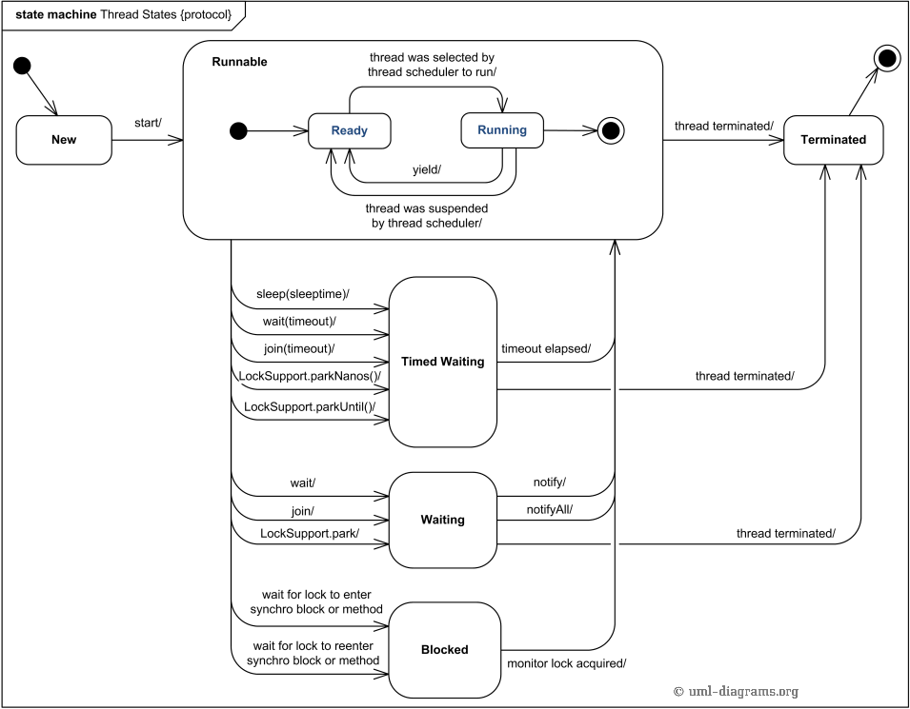
Thread States And Switching
PPT模板下载：www.1ppt.com/moban/ 行业PPT模板：www.1ppt.com/hangye/
节日PPT模板：www.1ppt.com/jieri/ PPT素材下载：www.1ppt.com/sucai/
PPT背景图片：www.1ppt.com/beijing/ PPT图表下载：www.1ppt.com/tubiao/
优秀PPT下载：www.1ppt.com/xiazai/ PPT教程： www.1ppt.com/powerpoint/
Word教程： www.1ppt.com/word/ Excel教程：www.1ppt.com/excel/
资料下载：www.1ppt.com/ziliao/ PPT课件下载：www.1ppt.com/kejian/
范文下载：www.1ppt.com/fanwen/ 试卷下载：www.1ppt.com/shiti/
教案下载：www.1ppt.com/jiaoan/ PPT论坛：www.1ppt.cn

Slide 4
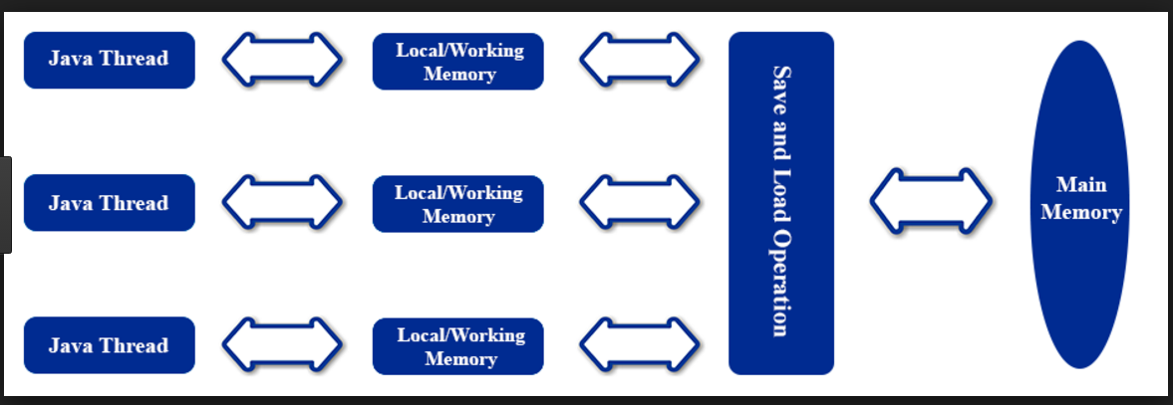
What is a Thread?
PPT模板下载：www.1ppt.com/moban/ 行业PPT模板：www.1ppt.com/hangye/
节日PPT模板：www.1ppt.com/jieri/ PPT素材下载：www.1ppt.com/sucai/
PPT背景图片：www.1ppt.com/beijing/ PPT图表下载：www.1ppt.com/tubiao/
优秀PPT下载：www.1ppt.com/xiazai/ PPT教程： www.1ppt.com/powerpoint/
Word教程： www.1ppt.com/word/ Excel教程：www.1ppt.com/excel/
资料下载：www.1ppt.com/ziliao/ PPT课件下载：www.1ppt.com/kejian/
范文下载：www.1ppt.com/fanwen/ 试卷下载：www.1ppt.com/shiti/
教案下载：www.1ppt.com/jiaoan/ PPT论坛：www.1ppt.cn

Slide 5
What is a Thread?
lock
unlock
read
load
use
assign
store
write
PPT模板下载：www.1ppt.com/moban/ 行业PPT模板：www.1ppt.com/hangye/
节日PPT模板：www.1ppt.com/jieri/ PPT素材下载：www.1ppt.com/sucai/
PPT背景图片：www.1ppt.com/beijing/ PPT图表下载：www.1ppt.com/tubiao/
优秀PPT下载：www.1ppt.com/xiazai/ PPT教程： www.1ppt.com/powerpoint/
Word教程： www.1ppt.com/word/ Excel教程：www.1ppt.com/excel/
资料下载：www.1ppt.com/ziliao/ PPT课件下载：www.1ppt.com/kejian/
范文下载：www.1ppt.com/fanwen/ 试卷下载：www.1ppt.com/shiti/
教案下载：www.1ppt.com/jiaoan/ PPT论坛：www.1ppt.cn

Slide 6
What is a Thread?
Almost every operating system supports independently running programs called processes. Threading is a facility to allow multiple activities to coexist within a single process. Java is the first programming language to explicitly include threading within the language itself, rather than treating it as a facility of the underlying OS.
Threads are sometimes called as lightweight processes. Like processes,they work independently and each thread has its own stack, program counter, and local variables. Even though they have their own stuff, threads within a process are less insulated from each other than separate processes are. They share memory space, file handles, etc. This means they have access to the same variables and objects. While this makes it easier for them to share information, the programmer must be very careful not to let them interfere with each other in the same process.
PPT模板下载：www.1ppt.com/moban/ 行业PPT模板：www.1ppt.com/hangye/
节日PPT模板：www.1ppt.com/jieri/ PPT素材下载：www.1ppt.com/sucai/
PPT背景图片：www.1ppt.com/beijing/ PPT图表下载：www.1ppt.com/tubiao/
优秀PPT下载：www.1ppt.com/xiazai/ PPT教程： www.1ppt.com/powerpoint/
Word教程： www.1ppt.com/word/ Excel教程：www.1ppt.com/excel/
资料下载：www.1ppt.com/ziliao/ PPT课件下载：www.1ppt.com/kejian/
范文下载：www.1ppt.com/fanwen/ 试卷下载：www.1ppt.com/shiti/
教案下载：www.1ppt.com/jiaoan/ PPT论坛：www.1ppt.cn

Slide 7
Netty Architecture
PPT模板下载：www.1ppt.com/moban/ 行业PPT模板：www.1ppt.com/hangye/
节日PPT模板：www.1ppt.com/jieri/ PPT素材下载：www.1ppt.com/sucai/
PPT背景图片：www.1ppt.com/beijing/ PPT图表下载：www.1ppt.com/tubiao/
优秀PPT下载：www.1ppt.com/xiazai/ PPT教程： www.1ppt.com/powerpoint/
Word教程： www.1ppt.com/word/ Excel教程：www.1ppt.com/excel/
资料下载：www.1ppt.com/ziliao/ PPT课件下载：www.1ppt.com/kejian/
范文下载：www.1ppt.com/fanwen/ 试卷下载：www.1ppt.com/shiti/
教案下载：www.1ppt.com/jiaoan/ PPT论坛：www.1ppt.cn

Slide 8

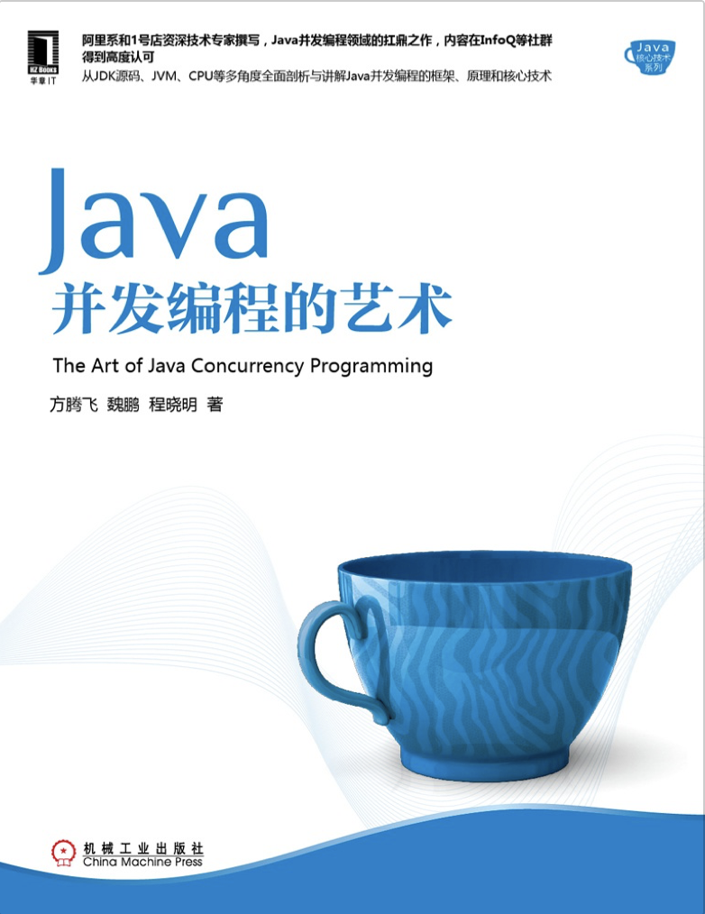
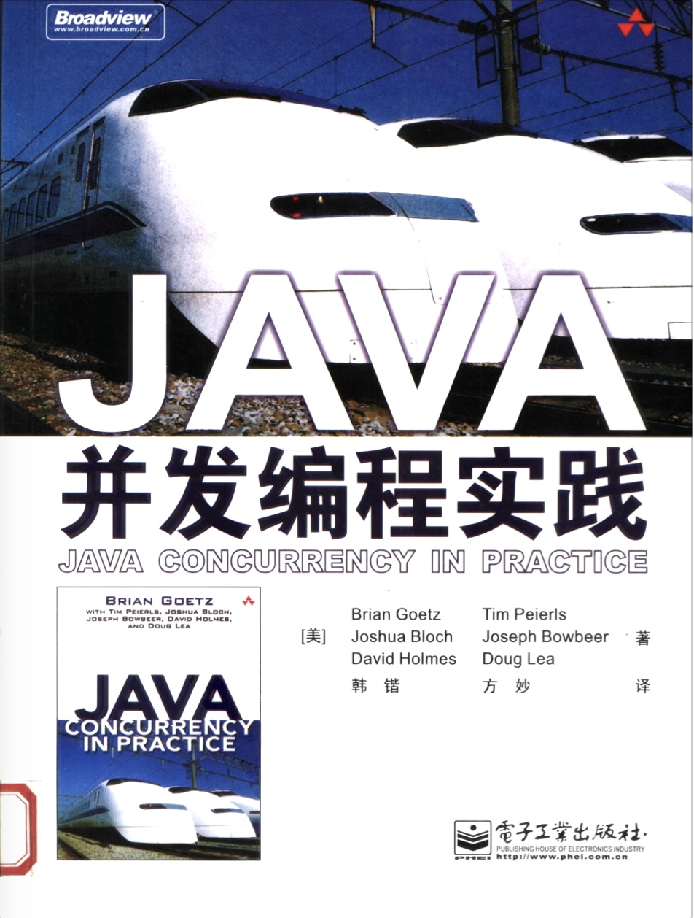
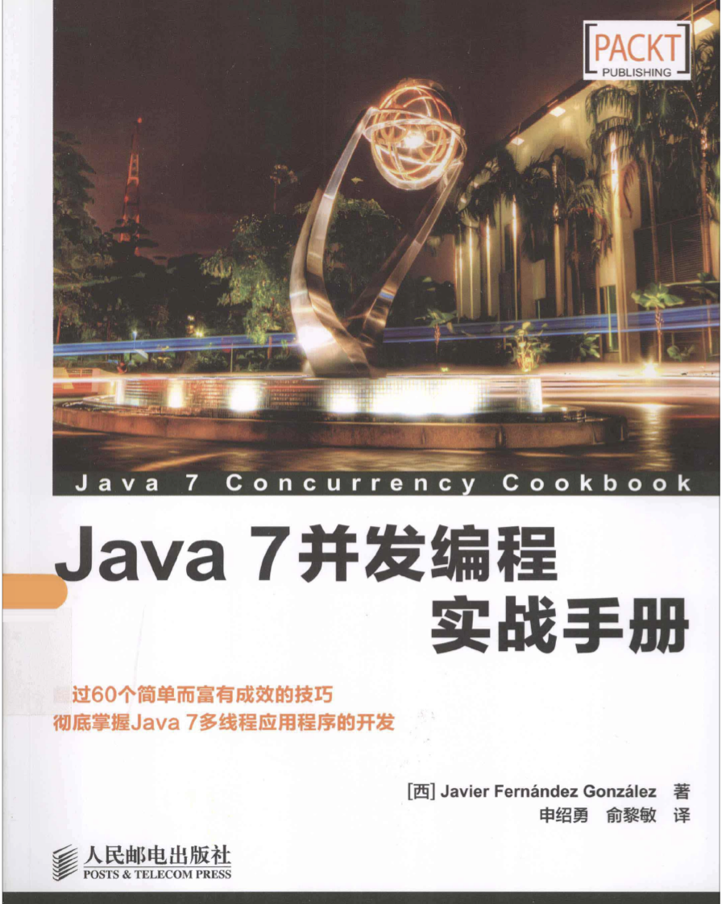
推荐书籍（1）
PPT模板下载：www.1ppt.com/moban/ 行业PPT模板：www.1ppt.com/hangye/
节日PPT模板：www.1ppt.com/jieri/ PPT素材下载：www.1ppt.com/sucai/
PPT背景图片：www.1ppt.com/beijing/ PPT图表下载：www.1ppt.com/tubiao/
优秀PPT下载：www.1ppt.com/xiazai/ PPT教程： www.1ppt.com/powerpoint/
Word教程： www.1ppt.com/word/ Excel教程：www.1ppt.com/excel/
资料下载：www.1ppt.com/ziliao/ PPT课件下载：www.1ppt.com/kejian/
范文下载：www.1ppt.com/fanwen/ 试卷下载：www.1ppt.com/shiti/
教案下载：www.1ppt.com/jiaoan/ PPT论坛：www.1ppt.cn

Slide 9
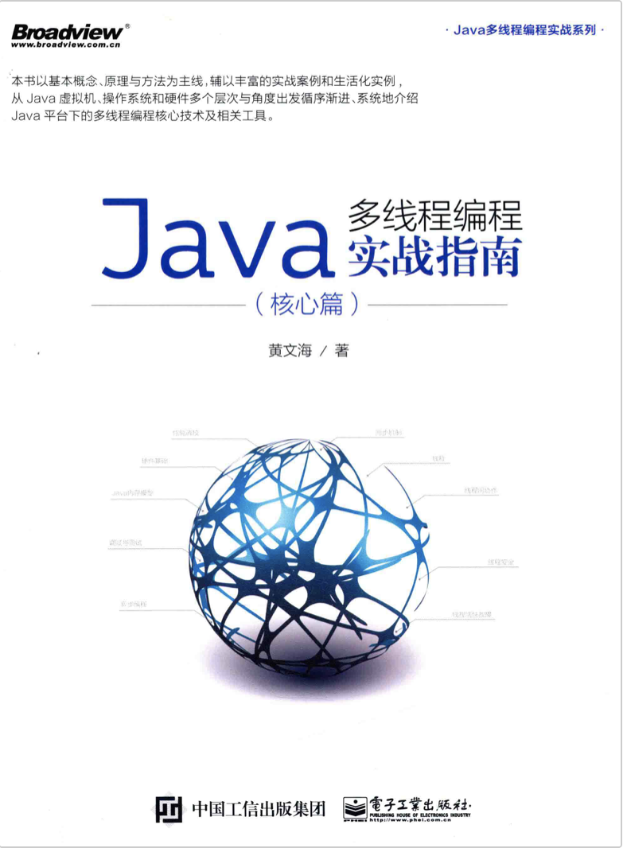
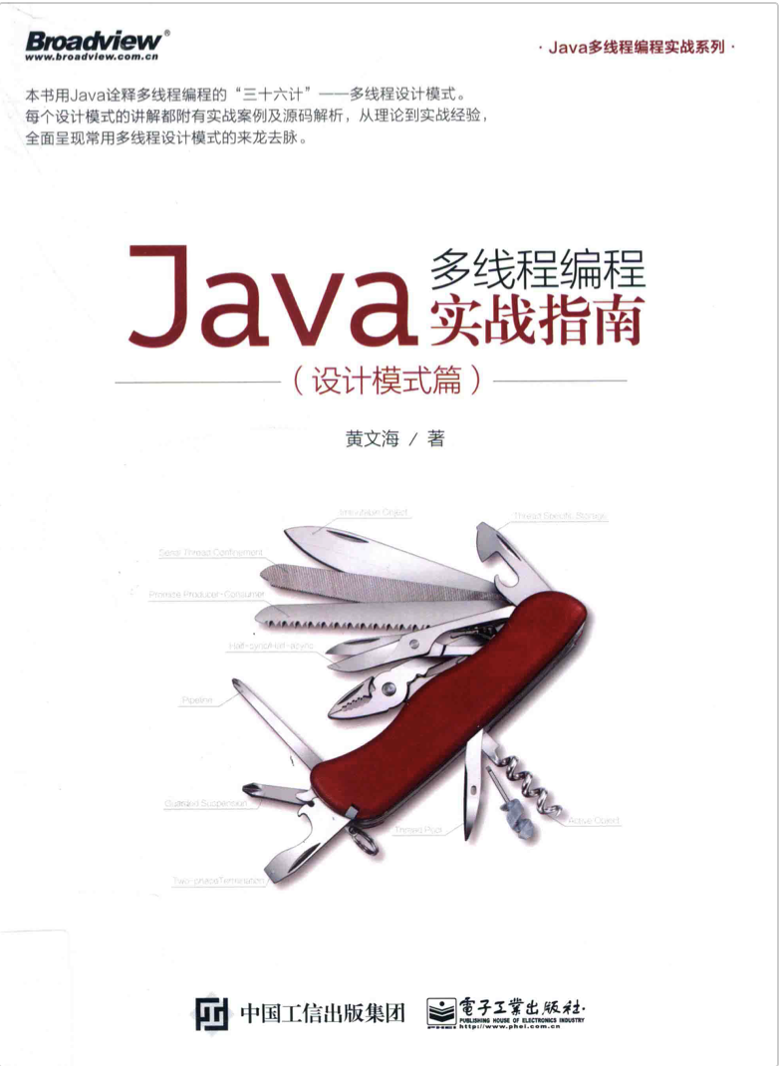
推荐书籍（2）
PPT模板下载：www.1ppt.com/moban/ 行业PPT模板：www.1ppt.com/hangye/
节日PPT模板：www.1ppt.com/jieri/ PPT素材下载：www.1ppt.com/sucai/
PPT背景图片：www.1ppt.com/beijing/ PPT图表下载：www.1ppt.com/tubiao/
优秀PPT下载：www.1ppt.com/xiazai/ PPT教程： www.1ppt.com/powerpoint/
Word教程： www.1ppt.com/word/ Excel教程：www.1ppt.com/excel/
资料下载：www.1ppt.com/ziliao/ PPT课件下载：www.1ppt.com/kejian/
范文下载：www.1ppt.com/fanwen/ 试卷下载：www.1ppt.com/shiti/
教案下载：www.1ppt.com/jiaoan/ PPT论坛：www.1ppt.cn

Slide 10

PPT模板下载：www.1ppt.com/moban/ 行业PPT模板：www.1ppt.com/hangye/
节日PPT模板：www.1ppt.com/jieri/ PPT素材下载：www.1ppt.com/sucai/
PPT背景图片：www.1ppt.com/beijing/ PPT图表下载：www.1ppt.com/tubiao/
优秀PPT下载：www.1ppt.com/xiazai/ PPT教程： www.1ppt.com/powerpoint/
Word教程： www.1ppt.com/word/ Excel教程：www.1ppt.com/excel/
资料下载：www.1ppt.com/ziliao/ PPT课件下载：www.1ppt.com/kejian/
范文下载：www.1ppt.com/fanwen/ 试卷下载：www.1ppt.com/shiti/
教案下载：www.1ppt.com/jiaoan/ PPT论坛：www.1ppt.cn

Slide 11

PPT模板下载：www.1ppt.com/moban/ 行业PPT模板：www.1ppt.com/hangye/
节日PPT模板：www.1ppt.com/jieri/ PPT素材下载：www.1ppt.com/sucai/
PPT背景图片：www.1ppt.com/beijing/ PPT图表下载：www.1ppt.com/tubiao/
优秀PPT下载：www.1ppt.com/xiazai/ PPT教程： www.1ppt.com/powerpoint/
Word教程： www.1ppt.com/word/ Excel教程：www.1ppt.com/excel/
资料下载：www.1ppt.com/ziliao/ PPT课件下载：www.1ppt.com/kejian/
范文下载：www.1ppt.com/fanwen/ 试卷下载：www.1ppt.com/shiti/
教案下载：www.1ppt.com/jiaoan/ PPT论坛：www.1ppt.cn

